Slide 1
Impact Evaluation Brown Bag
Intro to Analysis in R

Slide 2
Goals
Read data
Compute statistics
Randomly assign groups to treatment and control
Make nice graphs

Slide 3
To get started
Download R:
https://cran.cnr.berkeley.edu/
Install RStudio:
https://www.rstudio.com/products/rstudio/download/

Slide 4
What is R?
“R is a language and environment for statistical computing and graphics.”
There are a lot of ways to generate, manage, and analyze data
Many of these are proprietary
If Excel is television in the 1970s, R is streaming media in the 2010s
Notes:
Source: CRAN

Slide 5
Why R?
R is open source and free
Can read almost any file type
Can read any file size
Data from basically anywhere
Web scrappers
APIs
PDFs

Slide 6
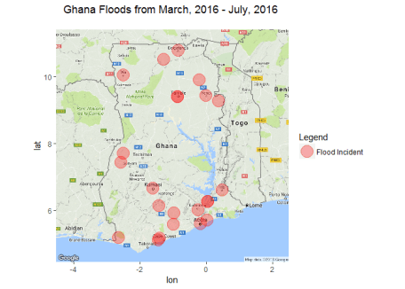
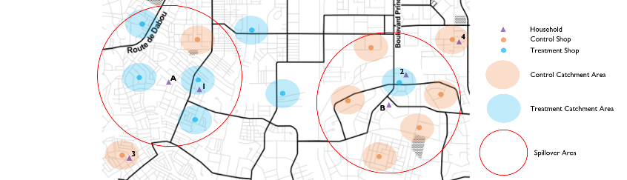
Why R?
Maps!

Slide 7
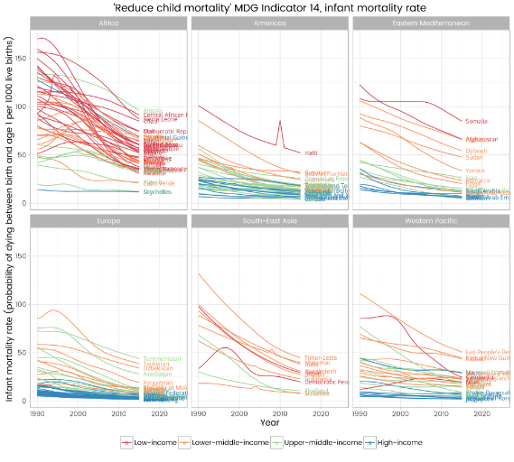
Why R?
APIs!
Notes:
API is short for Application Programming Interface. Basically, it means a way of accessing the functionality of a program from inside another program

Slide 8
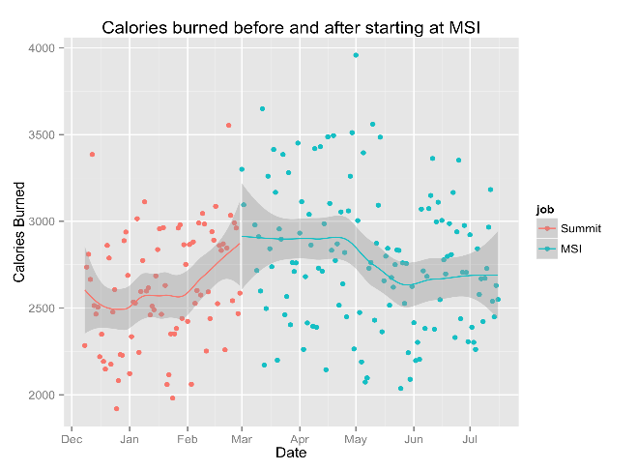
Why R?
APIs!
Notes:
API is short for Application Programming Interface. Basically, it means a way of accessing the functionality of a program from inside another program

Slide 9
Set up Directory
This gives R a reference point for loading and saving files
Find your current directory using getwd()
Set your working directory using setwd()
Example: setwd("C:/Users/jstein/Desktop/R stuff“)
Now, R will be able to pull any files in the Desktop folder called “R stuff”

Slide 10
R vs. Excel: Opening a file
Excel:
R:
hh <- read.csv("hh_91_practice.csv")
Notes:
Source: Andrew Ba Tran

Slide 11
R vs. Excel: Count Rows
Excel:
Several ways, but you could
=counta()
Create a pivot table
Scroll to the bottom of a column and rely on Excel’s row counter
R:
nrow()
nrow(hh)

Slide 12
R vs. Excel
You can do a lot in Excel now, but there are limits (e.g. large data sets)
Replicability can be critical
It can be confusing to follow the analytical process in Excel
R, like most statistical software, provides code that can be followed and shared

Slide 13
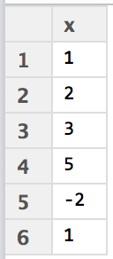
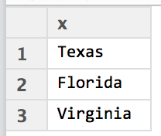
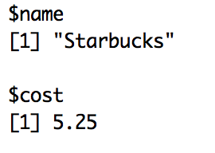
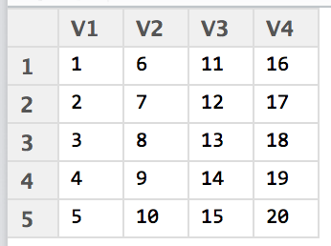
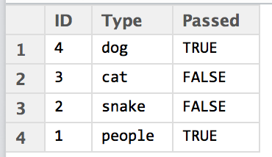
Data Structures in R
Same types of data
Mixed types of data
Vector
List
1-Dimension
Numeric
Character
Matrix
Data frame
2-Dimension
Notes:
Source: Andrew Ba Tran
Numeric Vector: nv <- c(1,2,3,5,-2,1)
Character Vector: cv <- c(“Texas”, “Florida”, “Virginia”)
Matrix: m <- matrix(1:20, nrow=5,ncol=4)
List: l <- list(name=”Starbucks”,cost=5.25)
Data frame: row1 <- c(4,3,2,1)
row2 <- c(“dog”,”cat”,”snake”,”people”)
row3 <- c(TRUE,FALSE, FALSE, TRUE)
allrows<- data.frame(row1,row2,row3)
colnames(allrows) <- c(“ID”,”Type”,”Passed”)

Slide 14
Today’s Code
Uses the Bangladesh Household Survey 1991/92 (baseline) and 1998/99 (endline)
Code based partly on Habiba Djebbari and María Adelaida Lopera’s Impact Evaluation using Stata
Helpful resources:
https://www.r-bloggers.com/
http://stackoverflow.com/questions/tagged/r
http://www.statmethods.net/
https://www.coursera.org/learn/r-programming

